Slide 1
Java Project
LAN chat & File sharing
Addagala Datta Deepak,16XJ1A0505
Abhinav Reddy Nimma,16XJ1A0504

Slide 2
Problem Statement :
Using technology to bring people together ,allow them to share files /messages despite of the geographical barriers (eg : between 2 blocks ) provide them recomendations and Private sharing facilities. To generate money from ads without intervening user activities and with out exploiting user’s privacy.

Slide 3
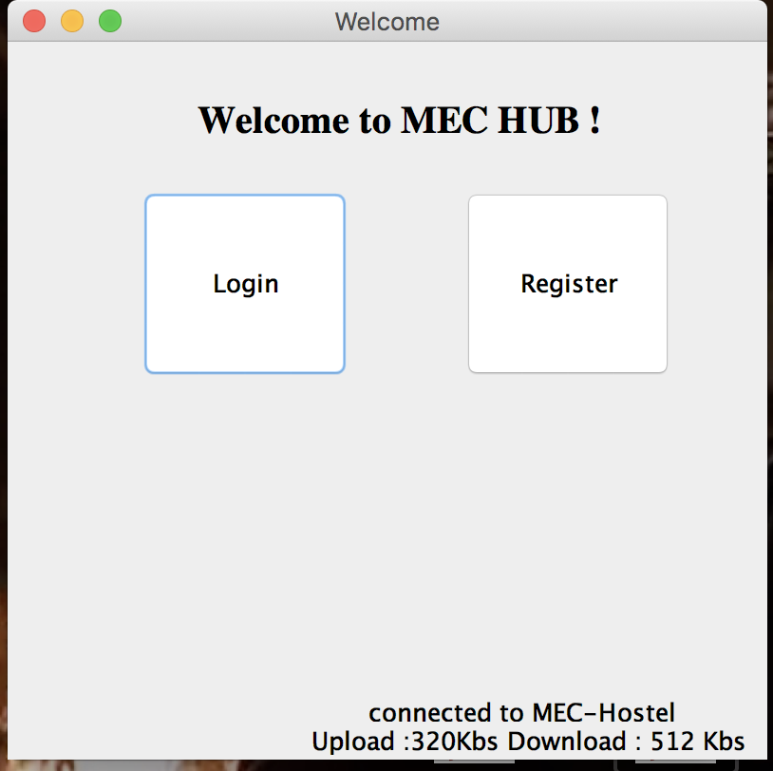
Welcome Page
-> Users should know connectivity
details before logging in and should
not blame company servers .
LAN chat & File sharing

Slide 4
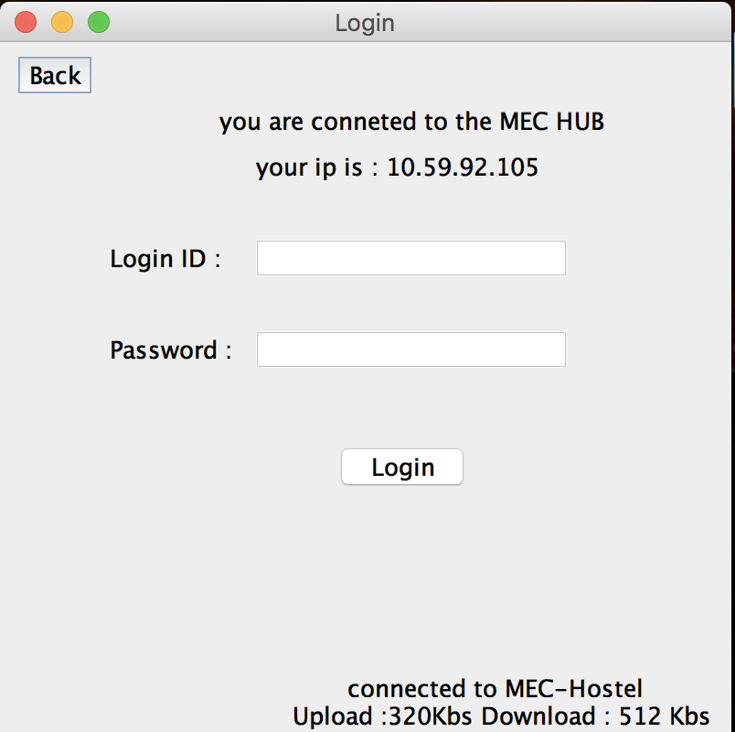
Login Page
Lan chat and wifi sharing
->User should always be able to go
back to the welcome page (with out irritating him to confirm resubmition

Slide 5
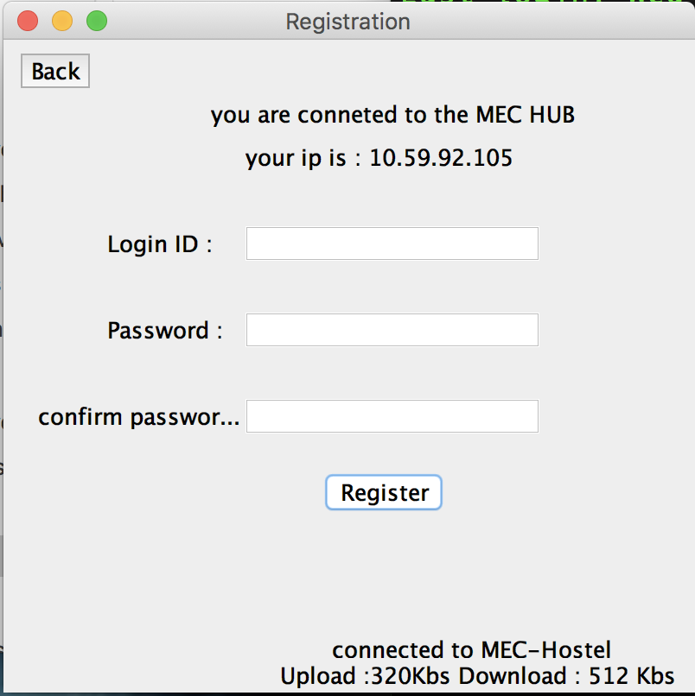
Registration page
Lan chat and wifi sharing
->Instant and Direct verification using
IP address.
->No additional OTP,SMS etc.
->User can always go back to welcome
page
->At every moment user will always be
aware of connectivity status.

Slide 6
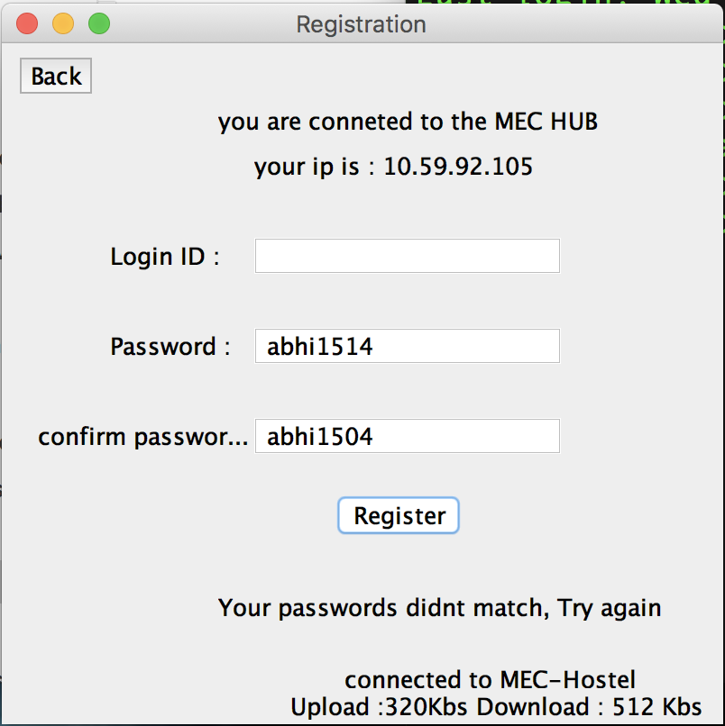
Registration failure
Lan chat and wifi sharing
->User will always be notified in case of
password mismatch

Slide 7

Successful Registration
Lan chat and wifi sharing
->From here user can either go to his
Social page or to his Home page

Slide 8
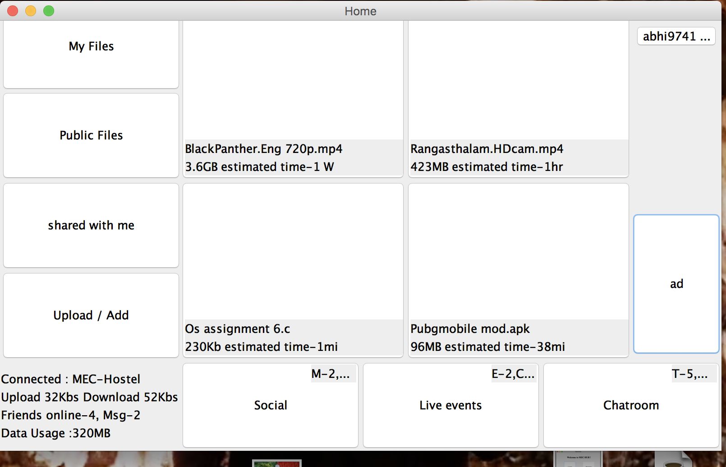
Compact Home Page
Lan chat and wifi sharing
->Should not waste
screen space
->Should be able to
select files without
much nagging.
->We should recomme-
-nd him files by not
keeping his private
data at stake (so that
nobody can exploit him)
hence we show him the
trending files.

Slide 9
Compact Home Page
Lan chat and wifi sharing
->Much details with in
short space,hence we
show no. of pending or
new actions so the user
need not waste his time
for checking.
->Ads (only monetary
source for developers)
Is placed such that it
does not interven user
actions but it influences
him (the reason why le-
-ave some space above
Advertisements :p.

Slide 10
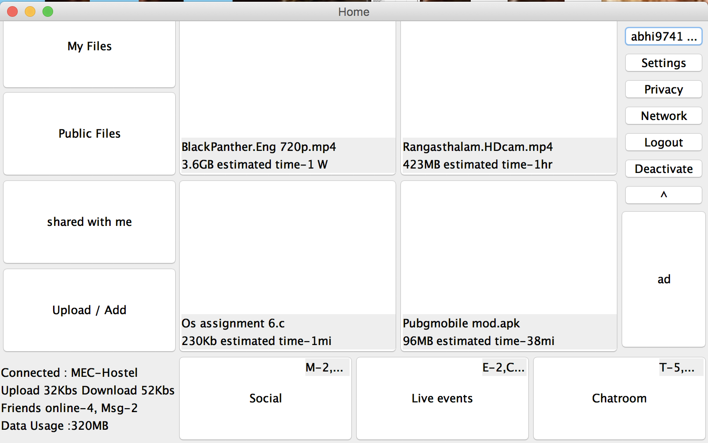
Drop down bar
Lan chat and wifi sharing
->Just a click on user
name will drop a set
of options (there is high
chance that user notices
the ad when the bar
drops suddenly.

Slide 11

Go Social
Lan chat and wifi sharing
->There is nothing
special here :(

Slide 12
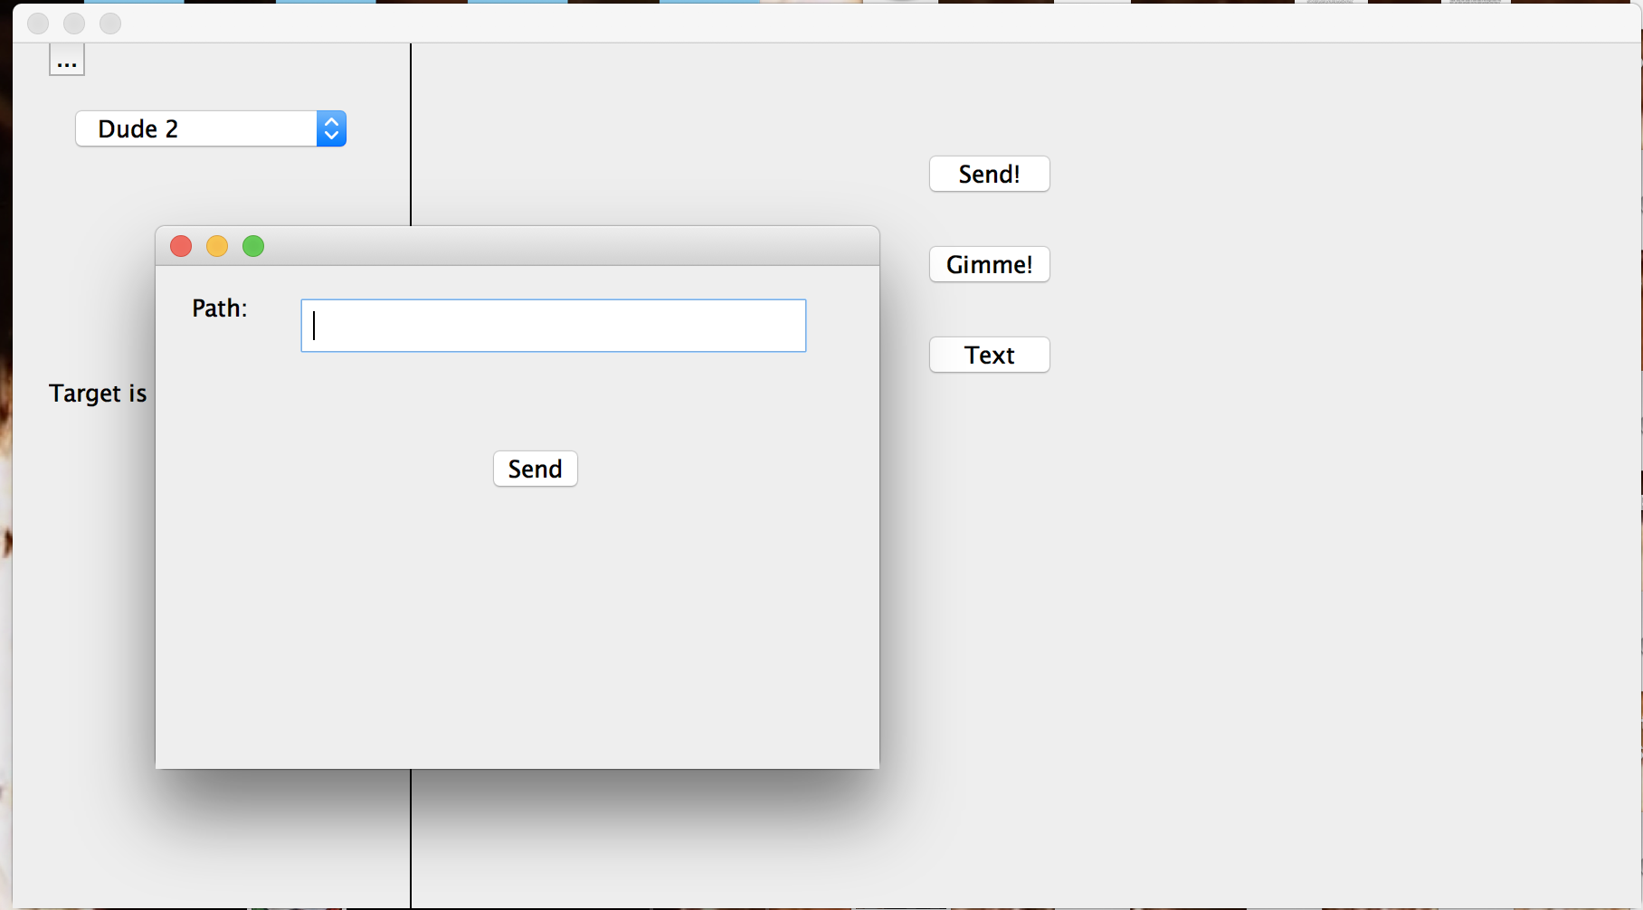
Sharing is caring
Lan chat and wifi sharing
->Instant sharing

Slide 13
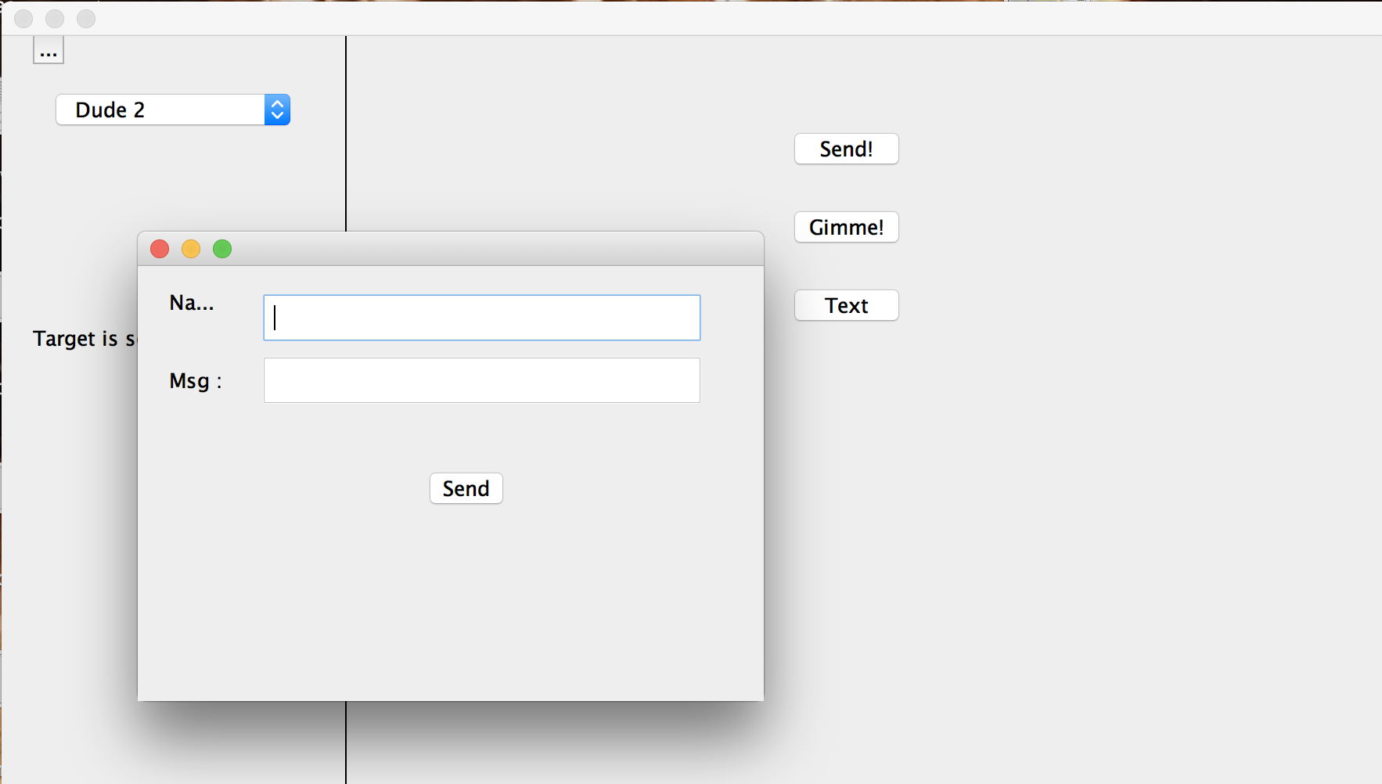
Instant messaging
Lan chat and wifi sharing

Slide 14
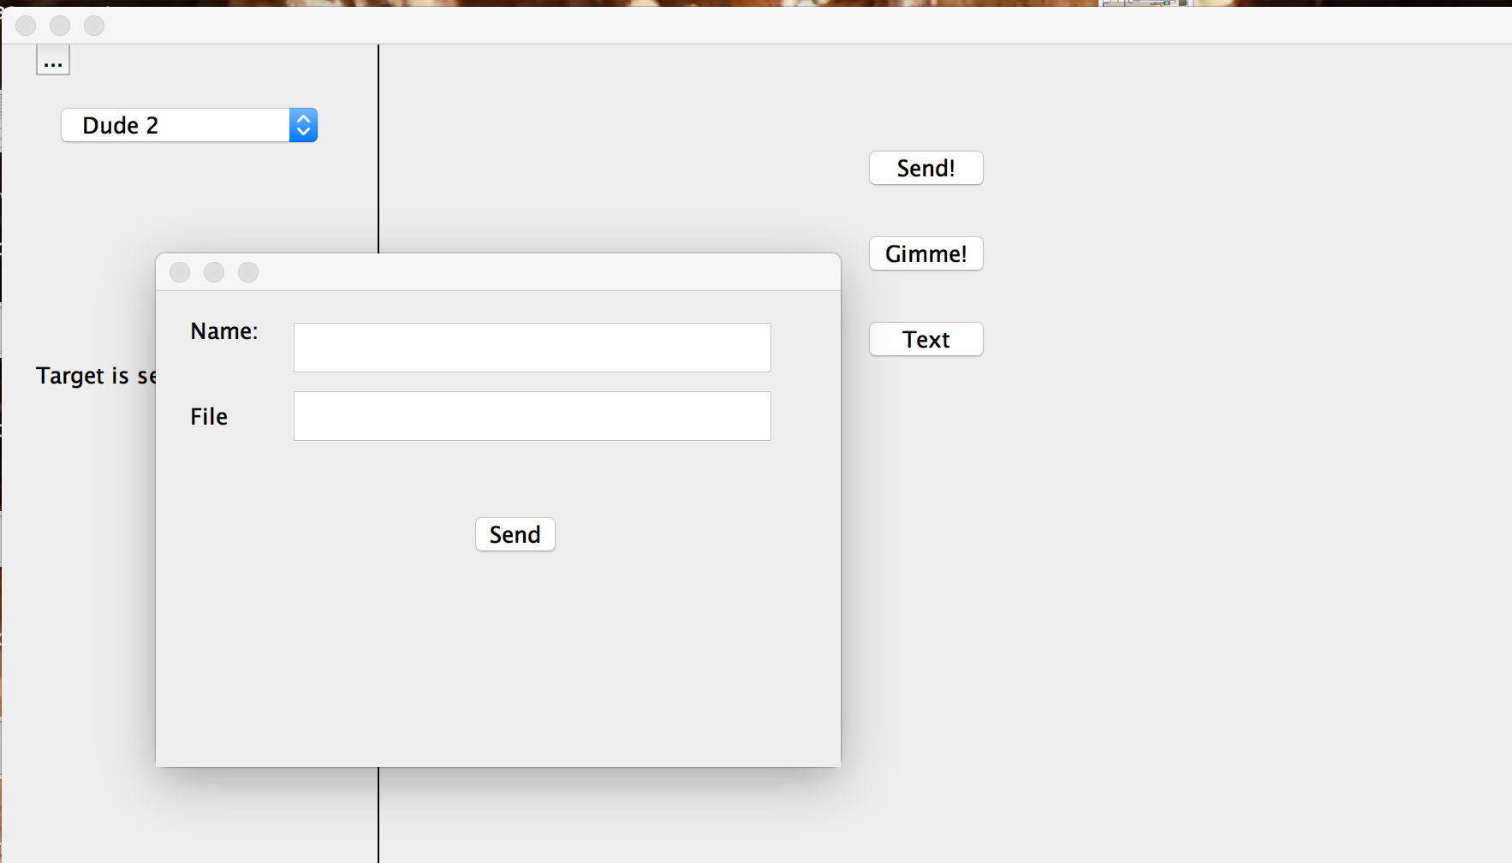
Private space
Lan chat and wifi sharing
->Ask people to
Share only with you.

Slide 15
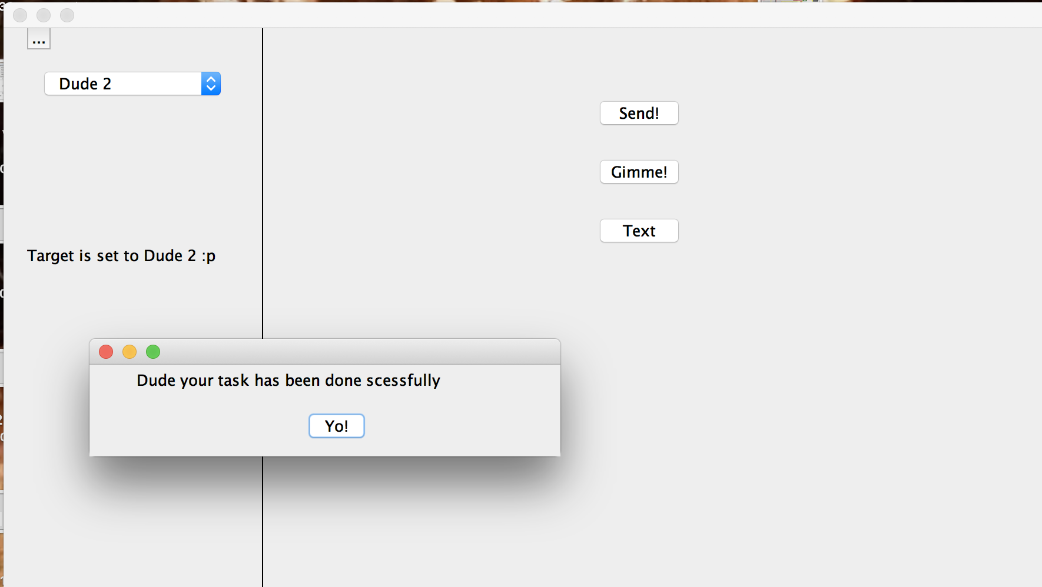
Acknowledgement
Lan chat and wifi sharing

Slide 16
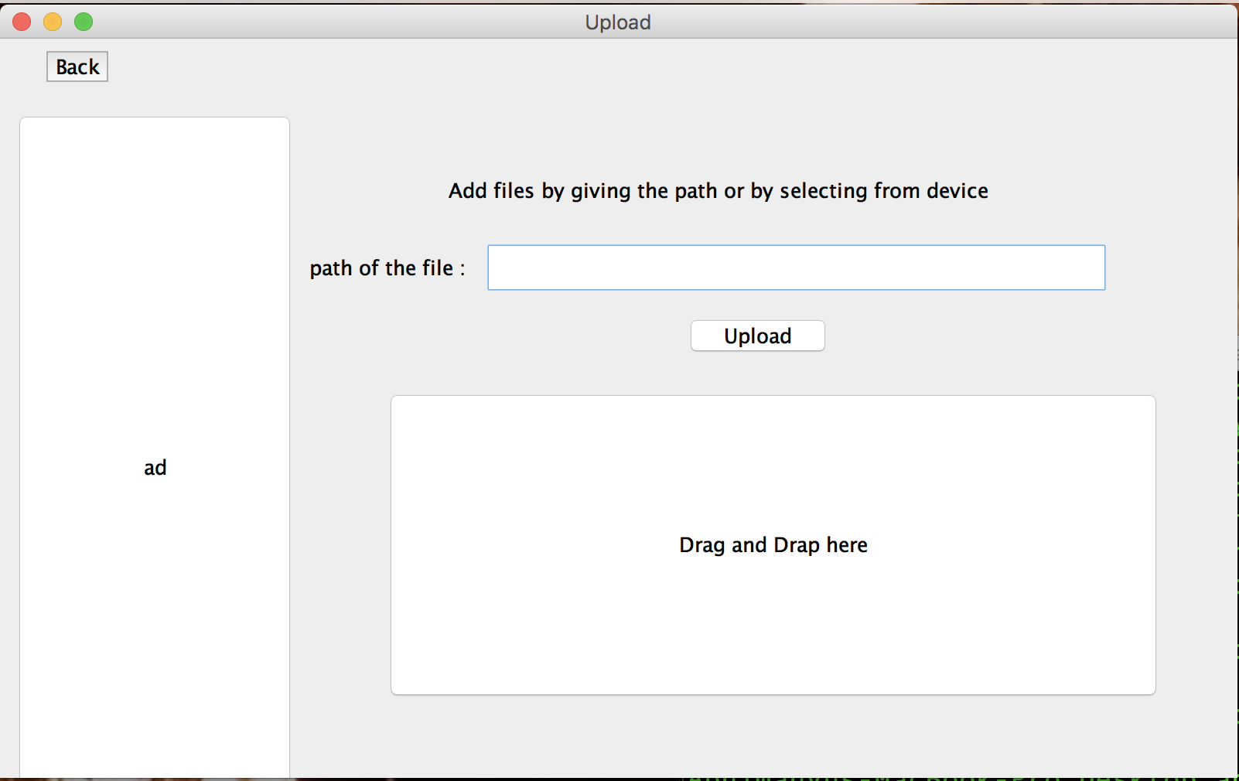
Upload files
Lan chat and wifi sharing

Slide 17
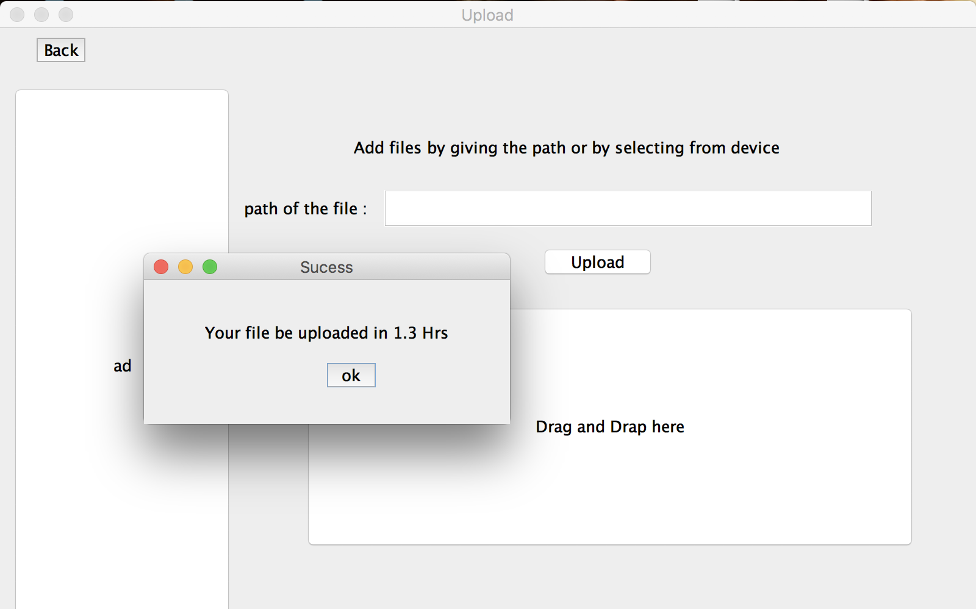
Estimated time
Lan chat and wifi sharing

Slide 18
We are open to ideas and suggestions
Constructive criticism is always welcomed
Lan chat and wifi sharing

